Slide 1
Assembling and Administering tests
Faculty of Nursing Cairo University
Evaluation & Testing in Nursing Education 02808
2nd Semester 2024/ 2025
Level: Doctorate
Supervised by
Prof. Dr. Effat Alkarmalawy
Prof. Dr. Enas Helmi
Assist. Prof. Dr. Heba Ahmad
Presented by:
Ayat Ebrahim
Eslam Ebrahim
Aisha Saad

Slide 2
Objectives
At the end of this discussion, each participant will be able to:
Demonstrate test design steps
Discuss test design rules.
Evaluate reproducing test rules.
Assess online testing rules.
Discuss benefits of Artificial Intelligence in tests and assessment.
Apply test administration steps.

Slide 3
Outlines
Introduction
Test design rules
Reproducing the test
Test administration
Online testing
Benefits of Artificial Intelligence in tests and assessment
Application
Reference

Slide 4
Introduction
Careful planning help avoid or minimize difficulties. Assembling is the process of organizing and putting together the individual components of a test. The goal is to create a cohesive, effective test that will accurately measure the intended skills, knowledge, or abilities. Administering a test usually is the simplest phase of the testing process.
(Oermann, Gaberson &De Gagne, 2025).

Slide 5
Introduction cont..
In addition to the preparation of a test blueprint and the skillful construction of test items that correspond to it, the final appearance of the test and the way in which it is administered can affect the validity of the test results.
There are some common problems associated with test administration, however, that also may affect the reliability of the resulting test scores and the validity of inferences made about those scores.
By Ensuring following design rules, teachers can avoid such errors when assembling a test.

Slide 6
Ensure Test design rules are followed
Avoid Crowding
Keep Related Material Together
Facilitate scoring
arrange in random way
Arrange Options in Logical or Numerical Order
Number the Items Consecutively Throughout the Test
Proofread
Prepare an Answer Key
Allow enough time
Arrange Test Items in a Logical Sequence
Write Directions
Use a Cover Page

Slide 7
Test design rules
1. Allow Enough Time
Assembling the test is not just a clerical or technical task; even if someone else types or reproduces the test, the teacher should make all decisions regarding the arrangement of test elements and the final appearance of the test. The teacher must allow enough time for this phase to avoid errors that could affect the students’ test scores. Creating a high-quality test requires time for both the item-writing phase and the design phases.

Slide 8
Test design rules cont..
2-Arrange Test Items
Arrangement of items including :
1- By order of simplest to complexity.
2- according to the sequence in which the content was taught.
3- according to teacher objectives and aim of the course.
4- according to test contains two or more formate the teacher group items of same format together because each items format requires diffirent mental tasks of the student.

Slide 9
Test design rules cont..
3-Write Directions
The test should begin with a set of clear general directions. These general directions should include instructions on:
•how and where to record responses?
•what type of writing implement to use?
•whether or not students may write on the test booklet?
•the amount of time allowed?
•the number of pages and items on the exam?
•the types and point values of items?
•whether students may ask questions during the test?
•what to do after finishing the exam?

Slide 10
Test design rules cont..
4-Use a Cover Page
The general test directions may be printed on a cover page.
Cover page serves to keep the test items hidden from view during distribution of exam, also to prevent the first students to receive the test from having more time to finish it than students who receive their copies later.
cover pages include number of pages and items so student check completense of exam.

Slide 11
Test design rules cont..
4- cover page

Slide 12
Test design rules cont..
5. Avoid Crowding
Test items are difficult to read when they are crowded together on the page
Indenting some components and allowing enough white space within and between items are two strategies that help students read more quickly and avoid mistakes when recording their answers.

Slide 13
Test design rules cont..
Avoid crowding
Example:
1.Which method of anesthesia involves injection of an agent into a nerve bundle that supplies the operative site?
A. General; B. Local; C. Regional; D. Spinal; E. Topical
The options are much easier to read if listed in a single column below the stem as in this example:
1. Which method of anesthesia involves injection of an agent into
•a nerve bundle that supplies the operative site?
A. General
B. Local
C. Regional
D. Spinal
E. Topical

Slide 14
Test design rules cont..
6. Keep Related Material Together
A multiple-choice item's and any associated answers should appear on the same page.
Additionally, the instructions for a matching exercise should be provided on a single sheet with both columns displayed side by side.
This arrangement facilitates reading materials and related questions.

Slide 15
Test design rules cont..
7. Facilitate Scoring
If the test will be scored by hand, the layout of the test or the answer sheet should facilitate easy scoring.
A separate answer sheet can be constructed to permit rapid scoring by comparing student responses to an answer key.
Example:

Slide 16
Test design rules cont..
1.List three responsibilities of the circulating nurse during induction of general anesthesia.
___________ _________________ _________________
Instead, the blanks should be arranged in a column along one side of the page, preferably on the left, as in this example:
1. ____________________________ | 1–3. List three responsibilities of the circulating nurse during induction of general anesthesia.
2. ____________________________
3. ____________________________

Slide 17
Test design rules cont..
8. Arrange the Correct Answers in a Random Pattern
Many teachers have a tendency to favor certain response positions for the correct or keyed answer to objective test items.
For example, to assign the correct response to the A or D position of a multiple- choice item.
Some teachers arrange test items so that the correct answers form a pattern that makes scoring easy (e.g., T-F-T-F, or A-B-C-D), the answers should be distributed by randomly assigned.
Test-wise- students may use such test characteristics to gain an unfair advantage.

Slide 18
Test design rules cont..
9. Arrange Options in Logical or Numerical Order
The response alternatives should be arranged according to a logical or meaningful order, such as alphabetical or chronological order, or in order of size or degree.
This type of arrangement reduces reading time and helps students who know the correct answer to search though the options to find it.

Slide 19
Test design rules cont..
Example for arrange Options in Logical or Numerical Order

Slide 20
Test design rules cont..
10. Number the Items Consecutively Throughout the Test
Throughout the test, test items should be numbered consecutively even if they should be grouped based on format.
That is, the teacher should not start each new item format section with item number 1 but continue numbering items in continuous sequence.
This numbering system helps students to find items they may have skipped and to avoid making errors when recording their answers, especially when using a separate answer sheet.

Slide 21
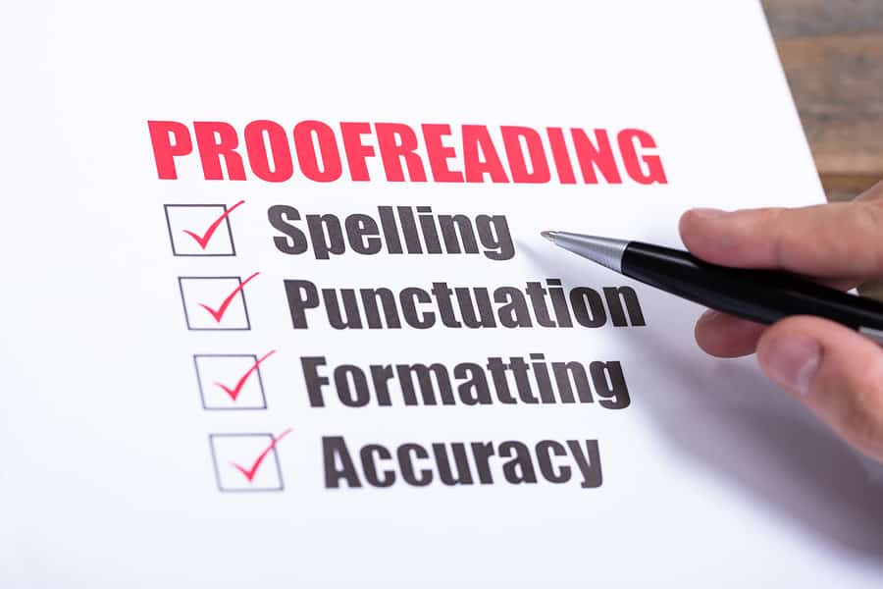
Test design rules cont..
11. Proofread
There should be no typographical, grammatical, punctuation, or spelling mistakes in the exam items or instructions. These flaws can lead to confusion and distraction, especially among anxious students, and are a source of measuring inaccuracy.

Slide 22
Test design rules cont..
12. Prepare an Answer Key
Whether the test will be machine-scored or hand-scored, the teacher should produce and validate an answer key in advance to assist quick scoring and to offer a last check on the accuracy of the test items.
Hand scoring is another option for scannable answer sheets; the correct answers can be indicated by punching holes in the sheet to create an answer key.

Slide 23
Reproducing the test
1. Assure Legibility
2. Print on One Side of the Page
3. Duplicate Enough Copies
4. Maintain Test Security

Slide 24
Reproducing the test cont..
1. Assure Legibility
When printing and reproducing the test, legibility is crucial because subpar copies can hinder students' ability to perform at their best.
It is advisable to use both upper- and lower-case lettering because a typeface with solely upper-case letters is hard to read.
(Oermann, Gaberson, De Gagne & Npd, 2024).

Slide 25
Reproducing the test cont..
1. Assure Legibility
The master or original copy should be letter-quality, produced with a laser or other high-quality printer so that it can be clearly reproduced.
For best results, the test should be photocopied or printed on a machine that has sufficient toner to produce crisp, dark print without any stray lines or artifacts.
(Oermann, Gaberson, De Gagne & Npd, 2024).

Slide 26
Reproducing the test cont..
2. Print on One Side of the Page
The test should be reproduced on only one side of each sheet of paper. Printing on both sides of each page could cause students to skip items unintentionally or make errors when recording their scores on a separate answer sheet. It also creates distractions from excessive page-turning during the test.
(Oermann, Gaberson, De Gagne & Npd, 2024).

Slide 27
Reproducing the test cont..
3. Duplicate Enough Copies
The teacher should duplicate more test copies than the number of students to allow for extra copies for proctors or to replace defective copies that may have been inadvertently distributed to students.
(Oermann, Gaberson, De Gagne & Npd, 2024).

Slide 28
Reproducing the test cont..
3. Duplicate Enough Copies
Displaying test items on a screen from an overhead projector or computer projector, or writing them on the chalkboard or interactive whiteboard, may save costs or the teacher’s preparation time, but these procedures may cause problems for students with learning or visual disabilities.
(Oermann, Gaberson, De Gagne & Npd, 2024).

Slide 29
Reproducing the test cont..
4. Maintain Test Security
Teachers have a serious responsibility to maintain the security of tests by protecting them from unauthorized access.
Carelessness on the part of the teacher can enable dishonest students to gain access to test materials and use them to obtain higher scores than they deserve.
(Oermann, Gaberson, De Gagne & Npd, 2024).

Slide 30
Reproducing the test cont..
4. Maintain Test Security
This contributes to measurement error, and it is unfair to honest students who are well-prepared for the test. It is up to the teacher to make arrangements to secure the test while it is being prepared, duplicated, stored, administered, and scored.
(Oermann, Gaberson, De Gagne & Npd, 2024).

Slide 31
Test administration
1. Environmental Conditions
2. Distributing the Test Materials
3. Answering Questions During the Test
4. Preventing Cheating
5. Collecting Test Materials

Slide 32
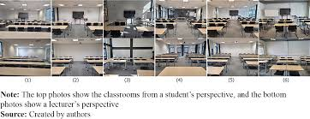
Test administration cont..
Environmental Conditions:
The environmental conditions of test administration can be a source of measurement error if they interfere with the students’ performance.
If possible, the teacher should select a room that limits potential distractions during the test.
(Oermann, Gaberson, De Gagne & Npd, 2024).

Slide 33
Test administration cont..
Environmental Conditions:
For example, if windows must be open for ventilation during warm weather, the students may be distracted by lawn mowing or construction noise; requesting a room on another side of the building may prevent the problem.
Placing a sign such as “Testing Quiet Please” on the door of the classroom may reduce noise in the hallway.
(Oermann, Gaberson, De Gagne & Npd, 2024).

Slide 34
Test administration cont..
2. Distributing the Test Materials
Careful organization allows the teacher to distribute test materials and give instructions to the students efficiently.
With large groups of students, several proctors may be needed to assist with this process.
(Oermann, Gaberson, De Gagne & Npd, 2024).

Slide 35
Test administration cont..
2. Distributing the Test Materials
If a separate answer sheet is used it usually can be distributed first followed by the test booklets.
During the distribution of the test booklets, the teacher should instruct students not to turn over the cover page and begin the test until told to do so.
(Oermann, Gaberson, De Gagne & Npd, 2024).

Slide 36
Test administration cont..
3. Answering Questions During the Test
Some students may find it necessary to ask questions of the teacher during a test, but responding to these questions is always somewhat disturbing to other students. Also, by responding to student questions during a test, a proctor may inadvertently give hints to the correct answer, which would put that student at an advantage while not making the same information available to other students.
(Oermann, Gaberson, De Gagne & Npd, 2024).

Slide 37
Test administration cont..
4. Preventing Cheating
A recent study found that a “steadily growing number of students cheat or plagiarize in college”.
The most common method of cheating was “letting others look at their papers while taking exams.” The most common reason for cheating was “not being ready for the exam.”
(Oermann, Gaberson, De Gagne & Npd, 2024).

Slide 38
Test administration cont..
4. Preventing Cheating
Ask Questions that Require High-Level Thinking
Use Varied Question Types
Have a Variety of Different Test Sets
Require cover sheets
Require desks to be clear
Don’t allow cell phones
Walk around the classroom
Have two versions of the test
Don’t allow students to get out of their seat or communicate
(Oermann, Gaberson, De Gagne & Npd, 2024).

Slide 39
Test administration cont..
5. Collecting Test Materials
For traditional on-site tests, when students are finished with the test and are preparing to leave the room, the resulting confusion and noise can disturb students who are still working.
The teacher should plan for efficient collection of test materials to minimize such distractions and to maintain test security. It is important to be certain that no test materials leave the room with the students.
(Oermann, Gaberson, De Gagne & Npd, 2024).

Slide 40
Online Testing

Slide 41
Online Testing
As more courses and programs are offered through distance education, teachers are faced with how to prevent cheating on an assessment when they cannot directly observe the students.
There are different approaches that can be used, ranging from administering the tests in a traditional, face-to-face session to using computer-adaptive tests.
In Online Testing , whether on- or off-campus, students must provide proof of identity.
The test can be set up to require the proctor to input his or her ID and a password known only to the proctor to start the exam.
(Oermann, Gaberson, De Gagne & Npd, 2024).

Slide 42
Online Testing
Key Features of Online Testing
Accessibility – Allows test-takers to participate from various location.
Automation – Enables instant grading and feedback.
Security Measures – Includes proctoring, randomized questions, and access controls.
Data Analytics – Tracks performance trends and identifies learning gaps.
Flexibility – Supports various question formats (multiple-choice, essay, simulations).
Bennett, R. E. (2020).

Slide 43
Online Testing cont..
3. Best Practices for Online Testing
Test Design
Align with learning objectives and assessment goals.
Use a mix of question types (MCQs, case-based, interactive).
Implement time limits to maintain test integrity.
Randomize questions and answer choices to reduce cheating.
Siau, K., & Nah, F. F. H. (2021)

Slide 44
Online Testing cont..
B. Security Measures
AI-Proctoring: Uses facial recognition and behavior monitoring.
Lockdown Browsers: Restricts access to other applications.
Question Banks: Generates unique tests for each student.
IP Restrictions: Limits test access to specific locations.
Siau, K., & Nah, F. F. H. (2021)

Slide 45
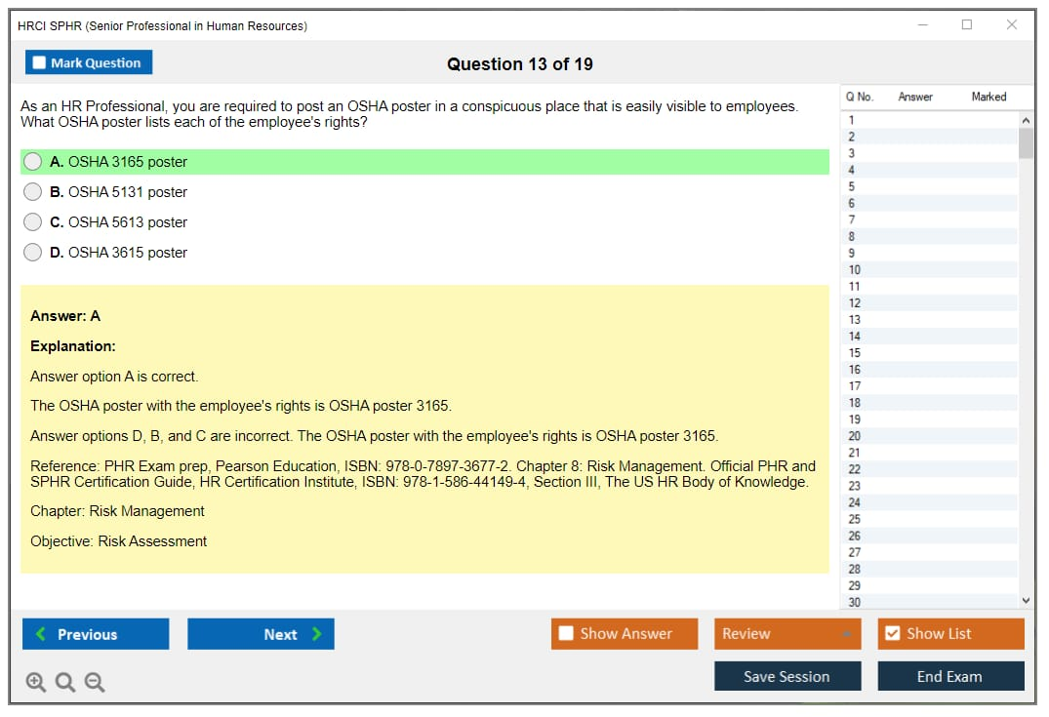
Online Testing cont..
C. Administration & Technical Considerations
Provide clear instructions on navigation and test-taking.
Offer a trial test to familiarize students with the platform.
Ensure compatibility across devices (laptops, tablets, mobile).
Have a backup plan in case of technical failures.

Slide 46
Online Testing cont..
D. Post-Test Analysis
Use automated grading for MCQs and structured responses.
Apply plagiarism detection for essay-type answers.
Analyze test reliability and validity through performance data.
Provide detailed feedback to enhance learning outcomes.
Siau, K., & Nah, F. F. H. (2021)

Slide 47
Online Testing cont..
C. Challenges in Online Testing
Cheating Prevention: Harder to monitor test-takers remotely.
Technical Issues: Internet disruptions, device compatibility.
Accessibility Concerns: Digital divide affecting disadvantaged learners.
Test-Taker Anxiety: Some students struggle with online exam environments.

Slide 48
Benefits of Artificial Intelligence cont.…
I-based exams (also known as AI-proctored tests) eliminate the need for onsite invigilators and can ensure a cheating-free environment. A proctor is a person who is certified to oversee the examination process. A remote proctor can oversee the exam from any location. Remote proctoring has made online exams very secure. When the exam begins, the audio and video feed of the student is sent to a proctor who will govern the exam. Voice and facial recognition technologies which are powered by AI can moderate exams without the need for human intervention.

Slide 49
Benefits of Artificial Intelligence cont.…
Automation of Administrative Tasks: AI can automate administrative tasks, freeing up valuable time for educators to focus on student engagement and instructional activities.
AI-powered systems can handle routine administrative tasks such as grading assignments, scheduling classes, and managing student records. This automation streamlines administrative processes, improves efficiency, and allows educators to dedicate more time to personalized instruction and mentorship.
Miguel A, (2024)

Slide 50
Benefits of Artificial Intelligence cont.…
Artificial Intelligence allows for faster, more efficient, and highly accurate testing methodologies. AI-powered testing tools can analyze vast datasets, and spot unobvious patterns and anomalies that human testers can miss.
AI in software testing executes repetitive tests and simulations at an accelerated pace, resulting in significant reductions in both testing time and costs.

Slide 51
Application
https://youtu.be/J_S34tZd9Ao?si=IO99dfKFu3NmFRB3

Slide 53
References
Newton, P. M., & Xiromeriti, M. (2023). ChatGPT performance on MCQ exams in higher education. A pragmatic scoping review. EdArXiv. February, 21.‏
Oermann, M. H., Gaberson, K. B., De Gagne, J. C., & NPD-BC, C. N. E. (2025). Evaluation and testing in nursing education. Springer Publishing Company. https://www.google.com.sa/books/edition/Evaluation_and_Testing_in_Nursing_Educat/TpawDwAAQBAJ?hl=ar&gbpv=1&dq=evaluation+and+Testing+in+Nursing+Education+books+assembling+and+administering+test&pg=PA201&printsec=frontcover
Mohan, R. (2023). Measurement, evaluation and assessment in education. PHI Learning Pvt. Ltd. Springer Publishing Company.
‏Miguel A, (2024), Artificial Intelligence and the Future of Teaching and Learning, Washington, ( 37-55).
Li, Z.,(2023). Diffurec: A diffusion model for sequential recommendation. ACM Transactions on Information Systems, 42(3), 1-28.‏
1. Bennett, R. E. (2020). “The Changing Nature of Educational Assessment: Implications for Validity.” Educational Measurement: Issues and Practice, 39(1), 53-59.https://doi.org/10.1111/emip.12355
2. Siau, K., & Nah, F. F. H. (2021). “Trust in Online Exams: Challenges and Future Directions.” Journal of Computer Information Systems, 61(3), 233-244.https://doi.org/10.1080/08874417.2020.1756659
3. Carter, R. A., Jr., et al. (2020). “The Impact of COVID-19 on College Student Experiences with Technology.” Computers and Education Open, 1, 100018.https://doi.org/10.1016/j.caeo.2020.100018

